Slide 1
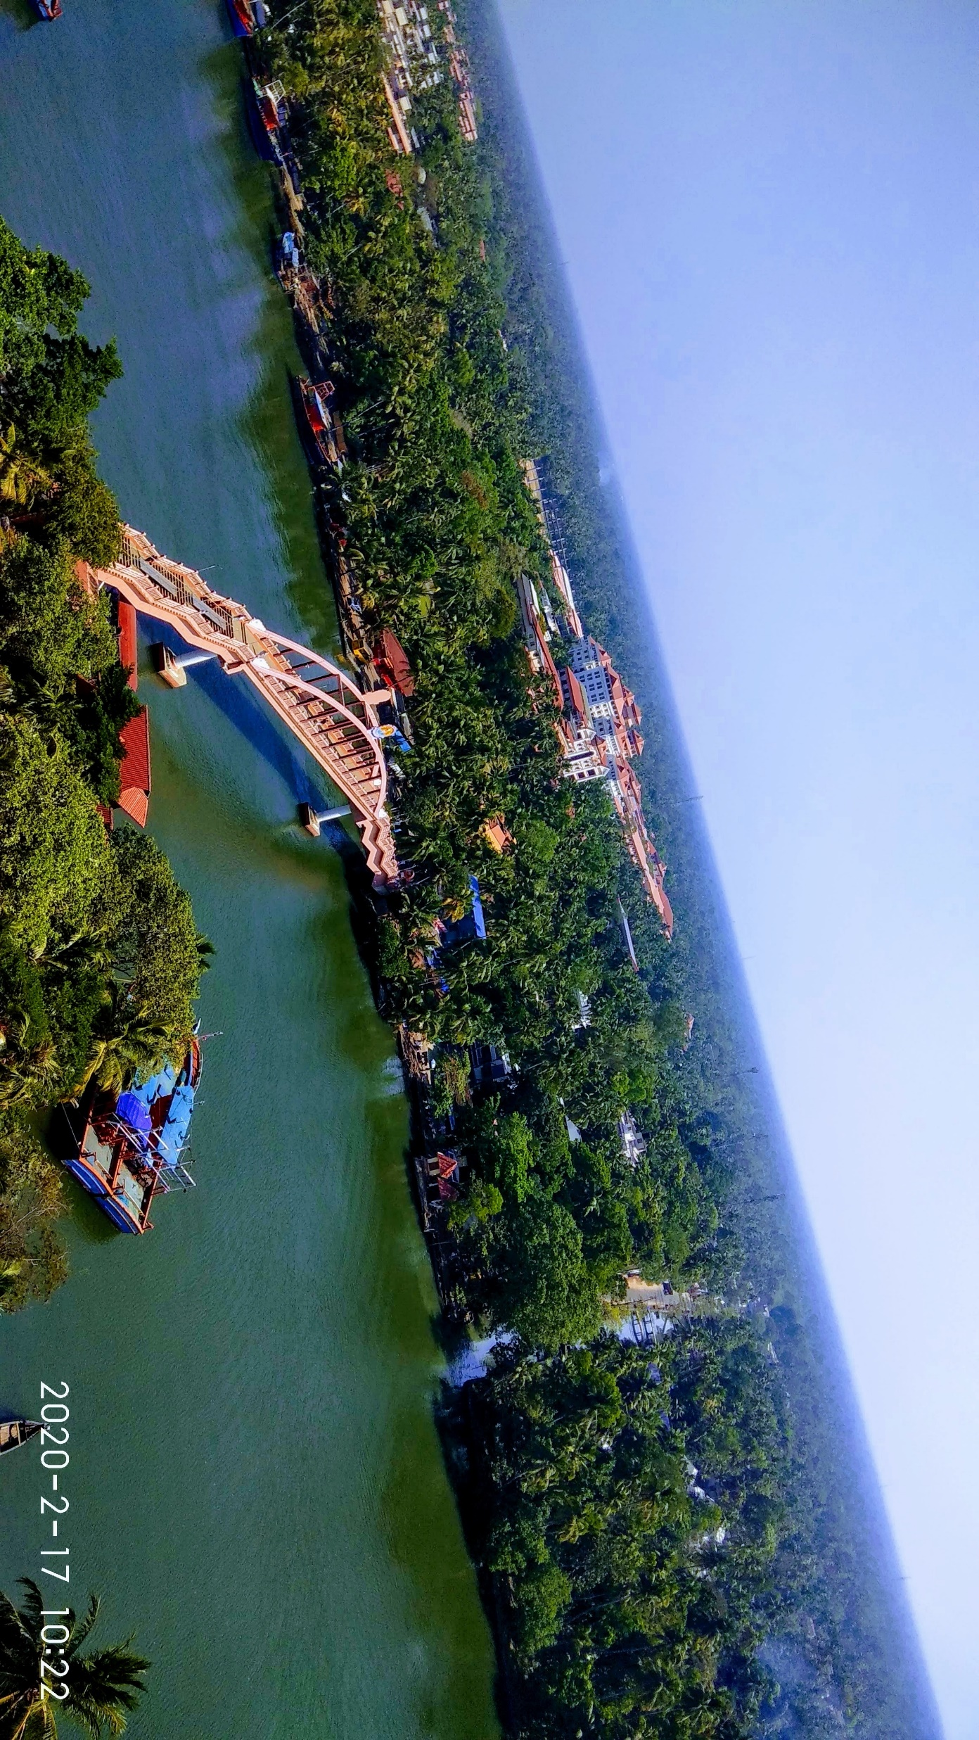

Low Cost VoIP Service for Marine Fishermen
Development and Performance Evaluation
Team Members:
1) Nadella Harshith
2) Nagamalla Charitha
Project Guide: Prof. Sethuraman N Rao
Mentor: Sai Shibu N B, Arjun D

Slide 2
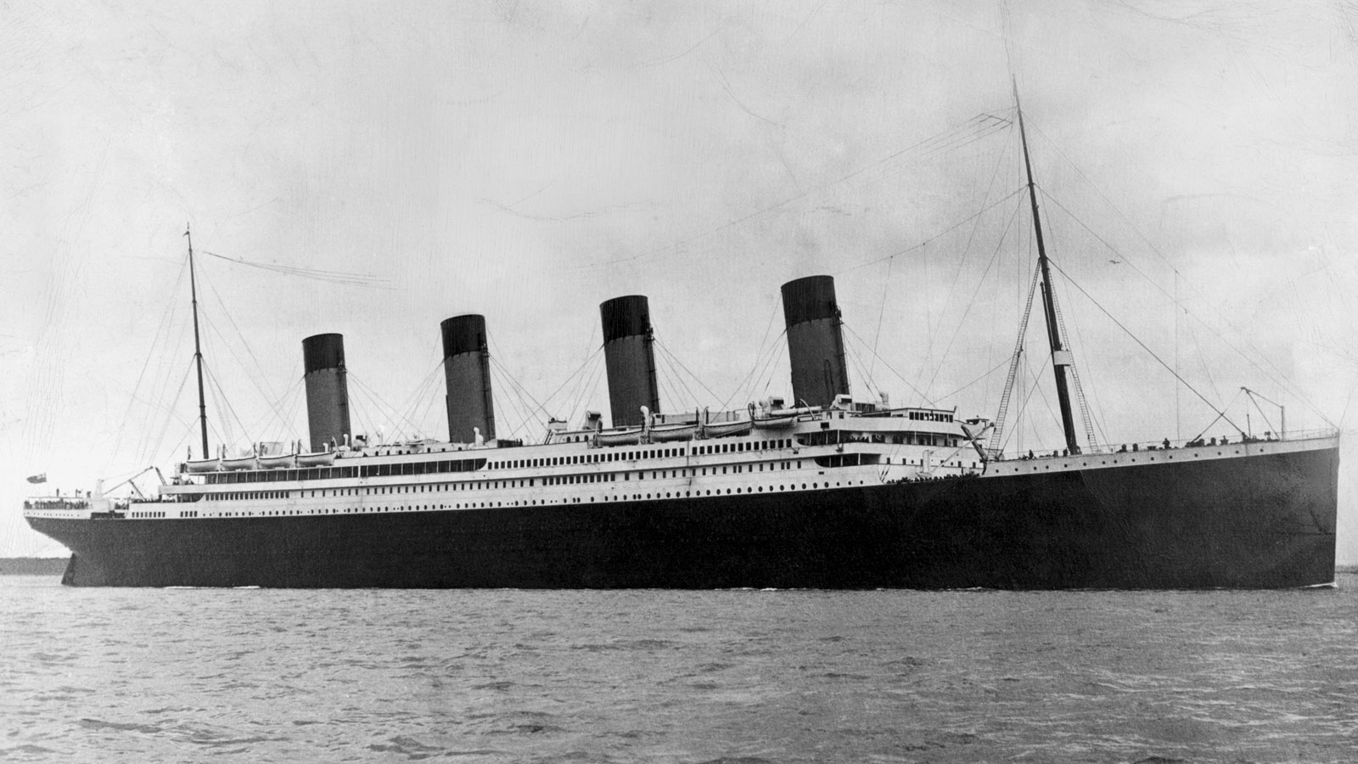
Introduction
Transition in Radio Technologies
Maritime Communications
Radio Act 1912
(Bands less than 200m wavelength)
Cellular range for Maritime Communications
Long Range Communications
Notes:
Intro about the different Radio Technologies from 19th century!
Discuss brief about what an onshore and offshore communication is!
Explain about Maritime communications explaining the legacy systems!
Radio Act 1912!
What is the cellular range for maritime communication and why its limited to certain range!
Explain about the long range communication and how this works by explaining the Marine communication scenario!
Explain the disadvantages of the legacy systems and how this issue can be resolved!
Explaining the facts about the issue….. explain the problem statement through which the issue can be resolved…… and theoretical explanation of terms related to the proposed solution i.e voip and its legacy protocols and the codecs used !
Explain the Network diagram in two ways how it can be placed!!!!!!!!!!!!!!!!!!!!!!!!!
Explain the Network Topology…………!(Packet Tracer)
Literature Survey- OceanNet How it has grown……..from the initial stage explaining the papers of OceanNet…………………………………….

Slide 3
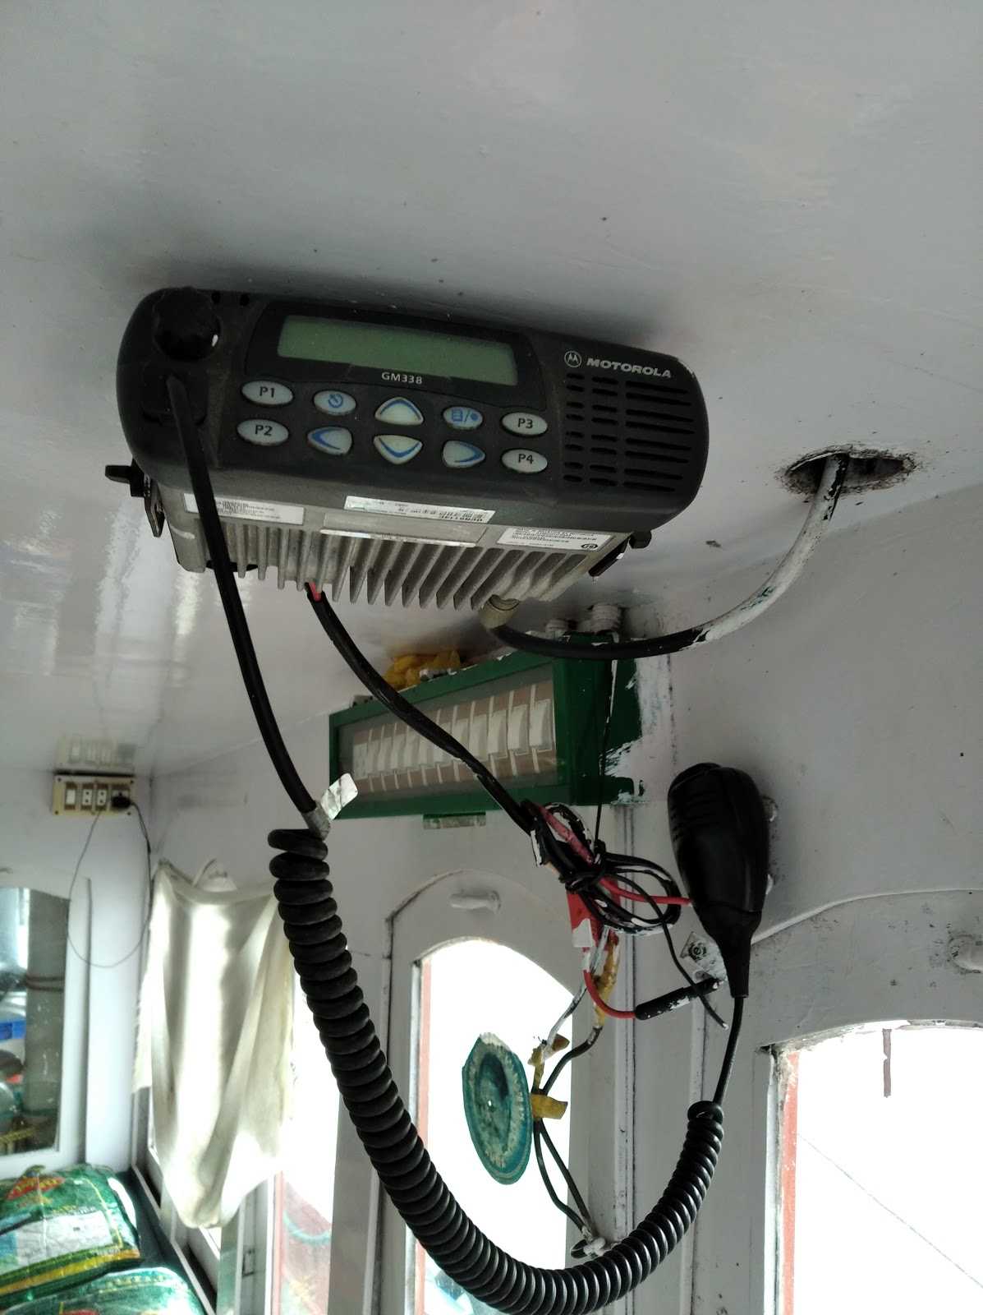
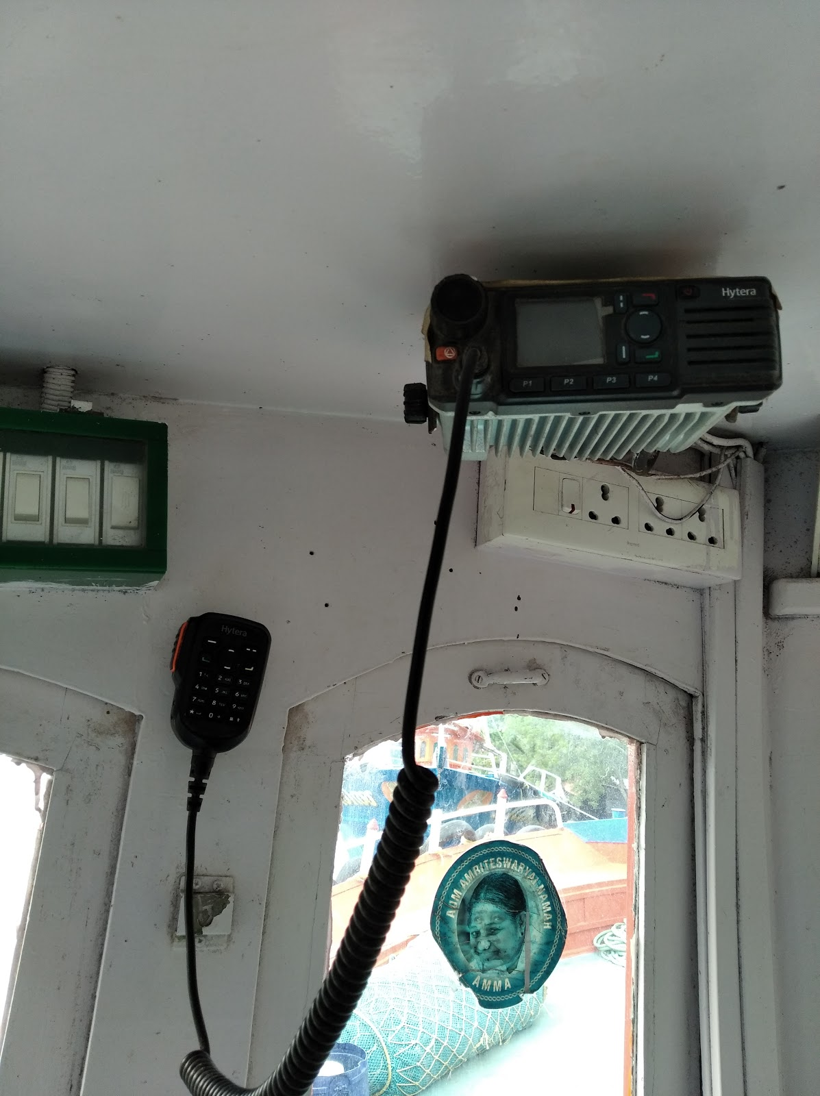
Current System
VHF Amateur Radio:
(Marine VHF Radio)
Marine VHF Radio uses the radio frequency spectrum for the exchange of non-commercial exchange of messages.
Operating Frequency range:156 MHz-172 MHz
(VHF Band =30MHz-300MHz)
Used for emergency broadcasts, experimentation purposes.
Satellite Phones

Slide 4
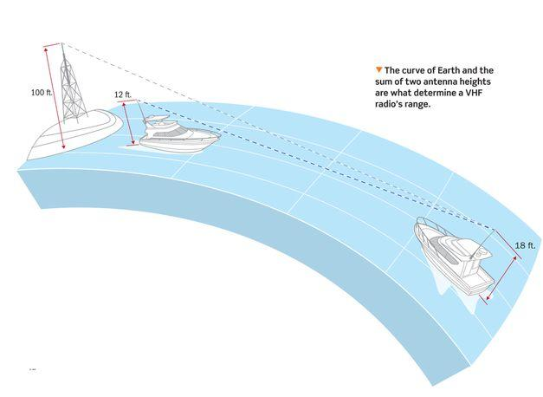
Marine Communication

Slide 5
Disadvantages of Current system
Marine VHF radios which are operating at these radio frequencies are affected due to weather changes and terrain conditions.
Require a power source for its functioning.
Not user-friendly, users needs skill to operate Marine VHF Radio.
Marine Radio users need License to operate VHF Amateur Radio.
Not Cost-Effective.

Slide 6
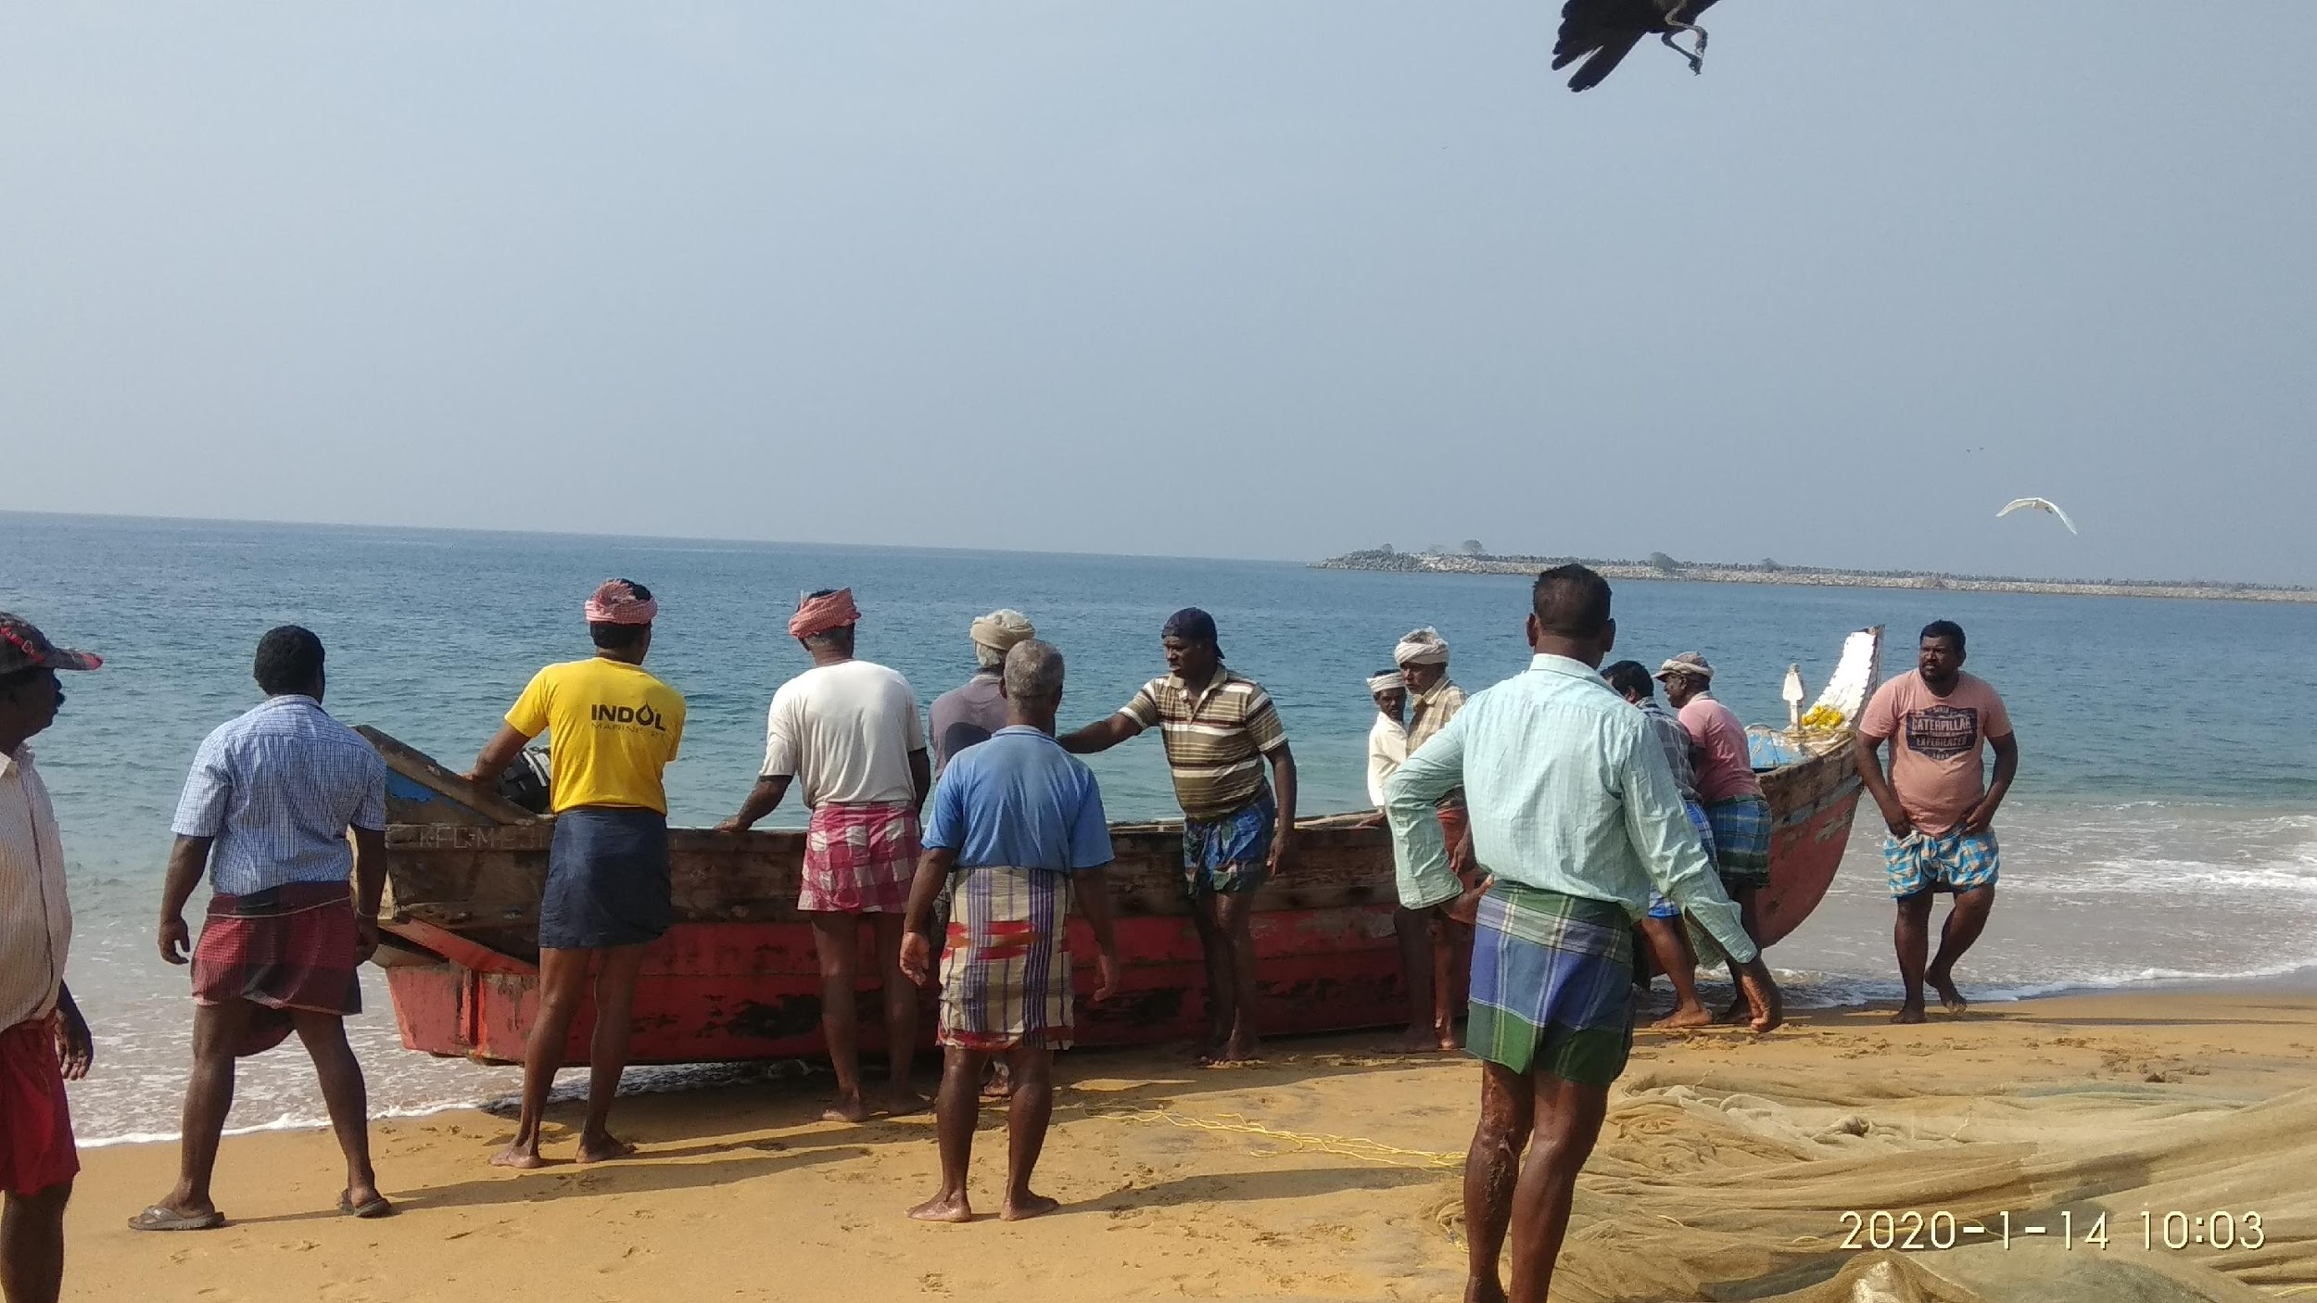
Problem Statement and Objective
Improvising the maritime communication system.
To provide cost-effective mode of Full Duplex communication for the marine fisherman which can overcome disadvantages of current system with the help of VoIP technology through existing Oceanet Backhaul Network.

Slide 7
OceanNet
Mobile infrastructure for coastal region offshore communications and networks
Abstract : To find a Cost-Effective solution which enables the fishermen to use the smart phones which they own already to get internet at sea using Wi-Fi. The Access Point (AP) on the boat connects over Ethernet to an onboard gateway to long range Wifi backhaul network. The onshore base station is installed on a tower at a height of 50-60 m. Boats are also used as mobile base stations to extend the range of the network. This solution, when tested over the Arabian Sea, provided a range of 40+ km in the first hop and 20+ km every subsequent hop.
Conclusion:
This network can be operated on a cooperative community basis by the fishermen community at reasonable per capita CAPEX (Capital Expenses) and OPEX (Operating Expenses).

Slide 8
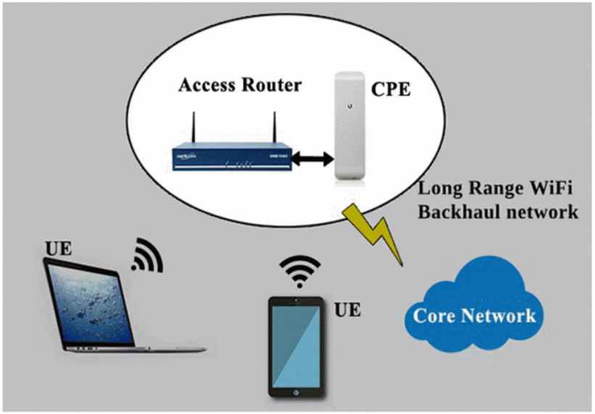
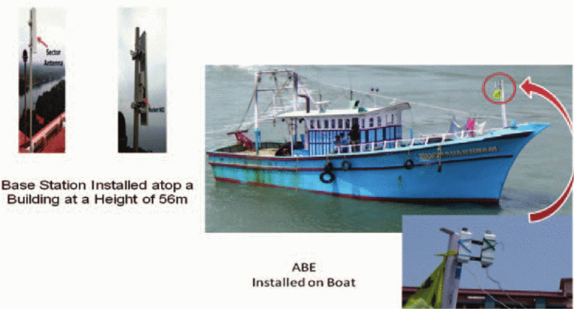
Adaptive Backhaul Equipment (ABE)

Slide 9
Study and analysis of OceanNet — Marine internet service for fishermen
Abstract: This paper discusses the variation in received power and transmitted power with respect to change in distance for a given frequency, comparison of channel bandwidth with channel capacity, analysis of signal to noise ratio and its impact on different modulation schemes. This paper also analyse different antenna types used for the deployment and how the performance is affected due to congestion in the nodes.
Conclusion:
It is seen that the received power at a given distance varies as a function of frequency, antenna heights, transmitted power and antenna gain. The obstructions along the propagation path have a great impact on the received signal strength.
(Antenna Type, Frequency, Climatic Conditions, Obstructions)

Slide 10
Automatic Antenna Reorientation System for Affordable Marine Internet Service
Abstract: The long range CPE(Consumer Premise Equipment) deployed in the boats used directional antennas. As the boat moves, the orientation of this directional antenna changes leading to loss of connectivity. In this paper, the authors proposed a solution to solve this problem by developing an automated antenna reorientation system that maintains the alignment between the CPE and the base station and ensures good connectivity.
Conclusion:
This system has improved the connectivity of the boats to a great extent.
Authors deployed an off-the-shelf semi-automatic rotating platform that has a remote control mechanism. The fishermen could use the remotes to manually set the direction such that the alignment is maintained.

Slide 11
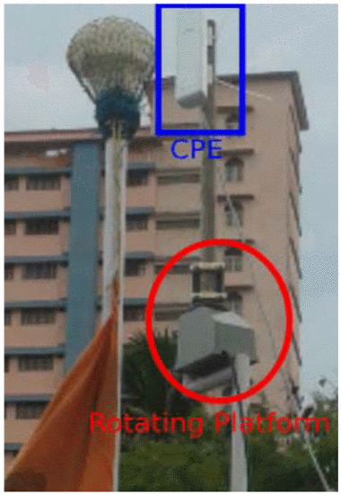

Slide 12
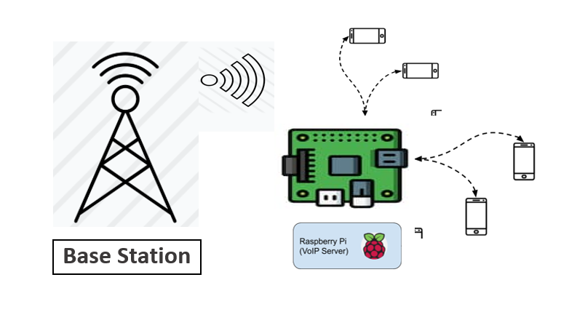
Proposed System
A Raspberry pi configured as a VoIP server which can be controlled through a network maintained by the Base station. The devices which are connected to the same network can have the access of VoIP server through which VoIP calls are processed.

Slide 13
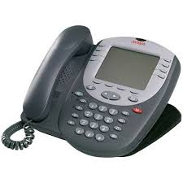
What is VoIP ?
Acronym VoIP stand for
“Voice over Internet Protocol”
Also called as IP Telephony.
System requires IP PBX for functioning.
VoIP calls uses the support of “SIP(Session initiation protocol)” an application layer Protocol for the establishment, modification and termination of multimedia Sessions.

Slide 14
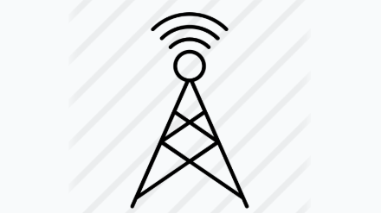
Service providers Base-station OceanNet (LR Wifi) Base station
Provides connectivity(Cellular) Normal calling,wifi calling Limited to 8-9 nautical miles for maritime communication. High OPeX and CAPeX
Provides wifi connectivity (2.4GHz) 40+ km in first Hop and 20+ km in second Hop Reasonable OPeX and CAPeX Provides Only Connectivity

Slide 15
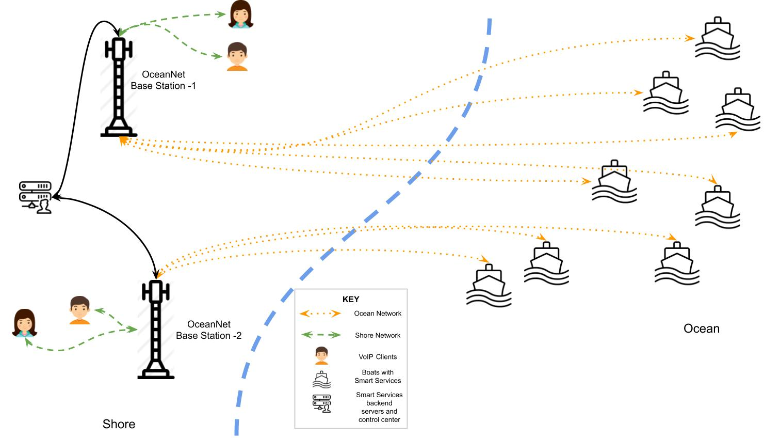
Network Diagram

Slide 16
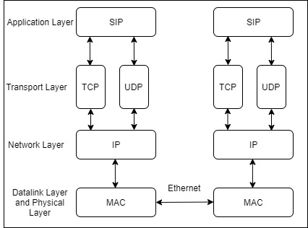
SIP Protocol-Layered Architecture

Slide 17
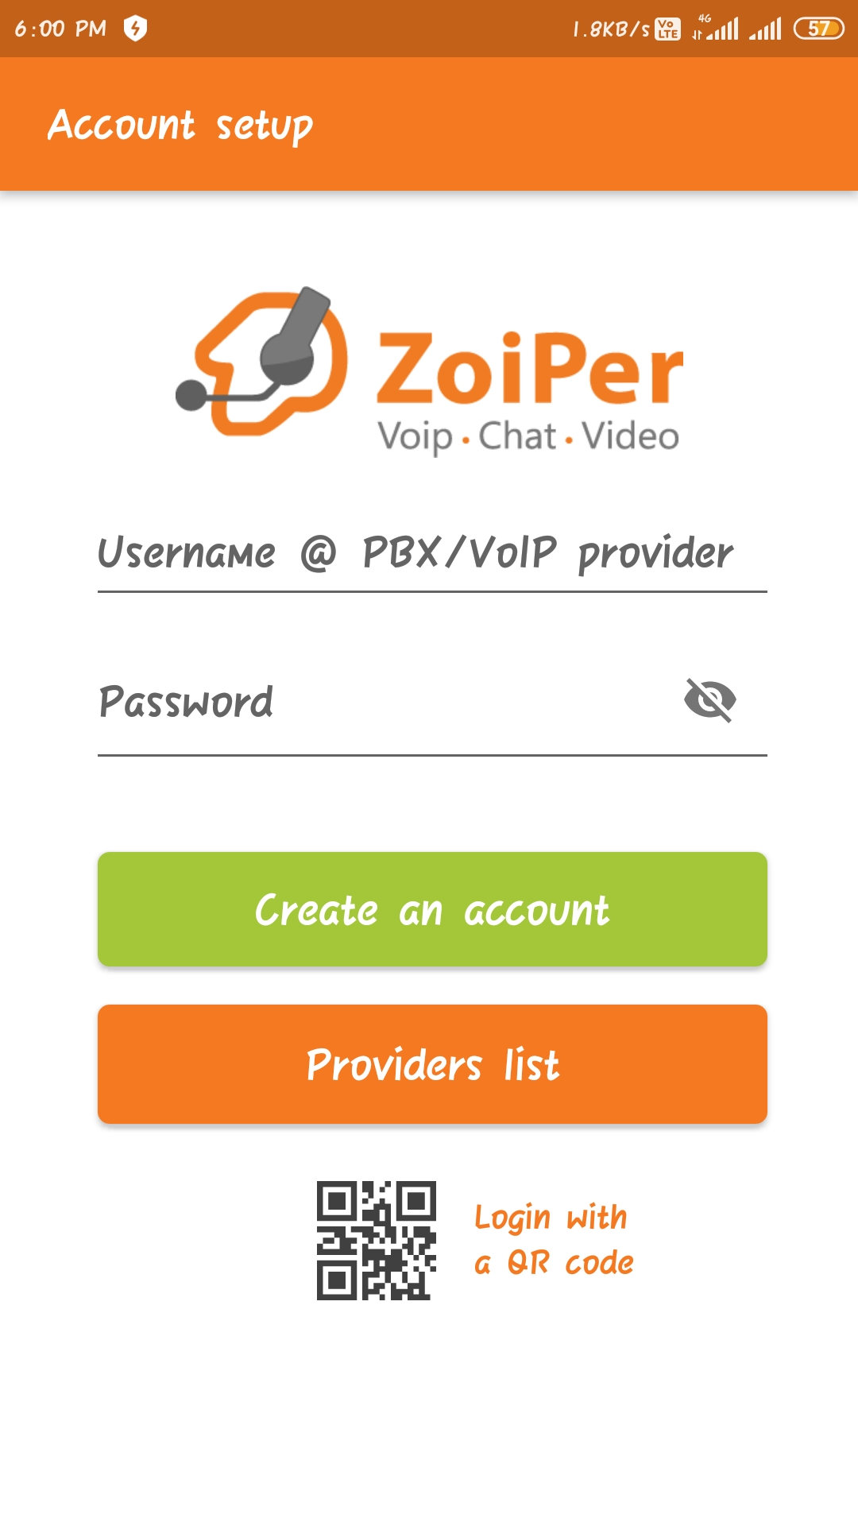
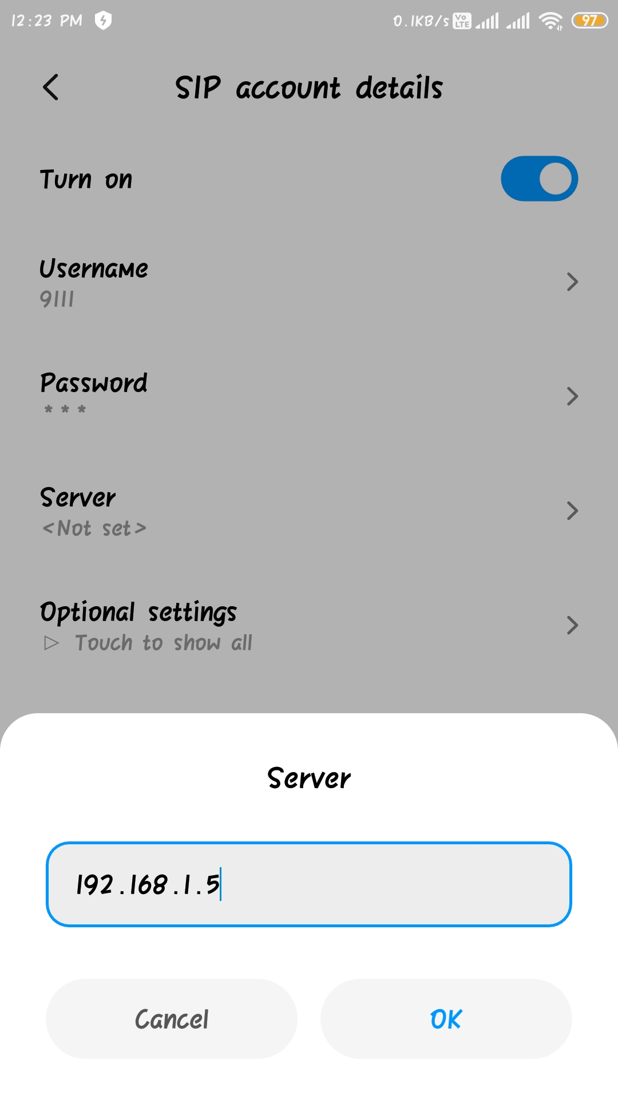
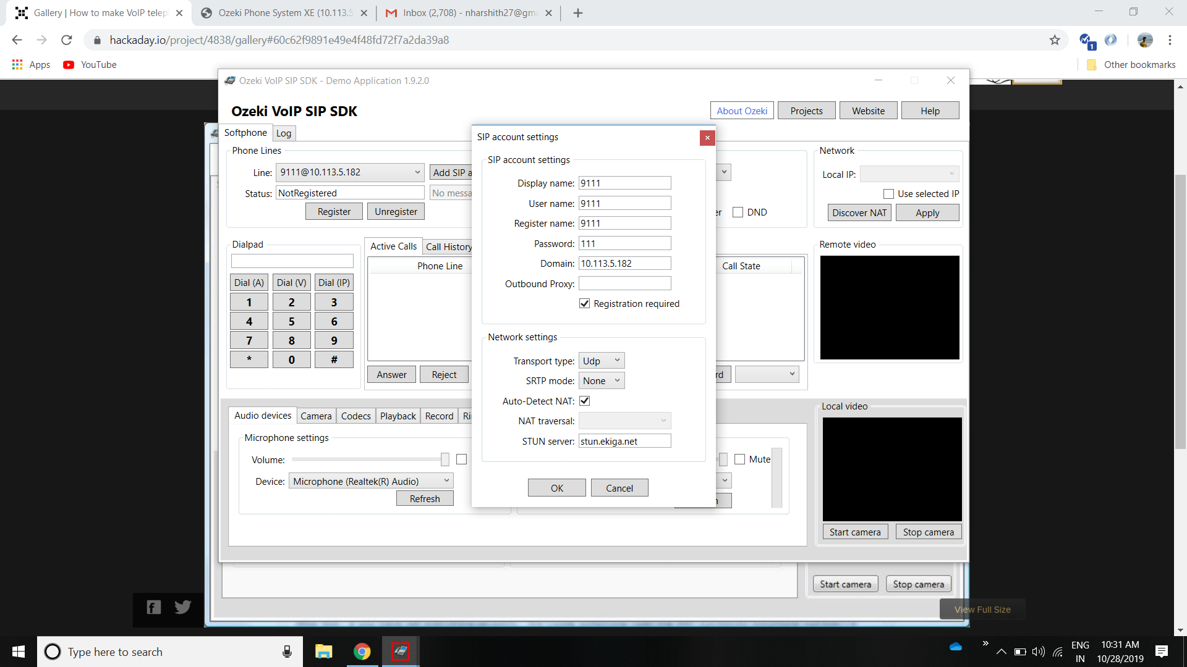
Different Types of VoIP Clients
Android SIP Application
Android SIP Clients
PC Based -SIP Clients

Slide 18

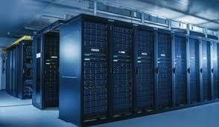
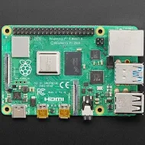
Performance Evaluation of VoIP Server
Call Latency Offered by Server
CPU Load on the VoIP Server

Slide 19
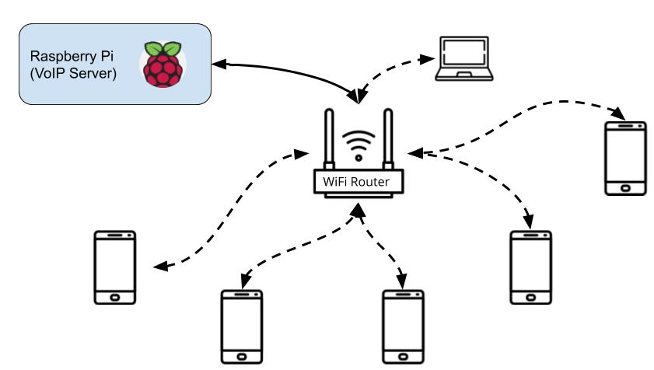
CPU Load on the VoIP Server

Slide 20
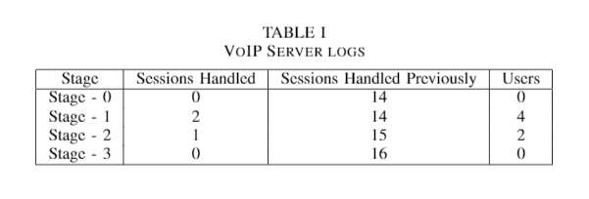
Table I shows the summary of call sessions. In stage - 0, which is the idle state, the VoIP server
had handled 14 sessions earlier. In the stage - 1, two parallel sessions were initiated through which
four users were communicating to each other. In the stage - 2 one of the sessions was closed and
the other session was active. In stage - 3 all sessions were closed.

Slide 21
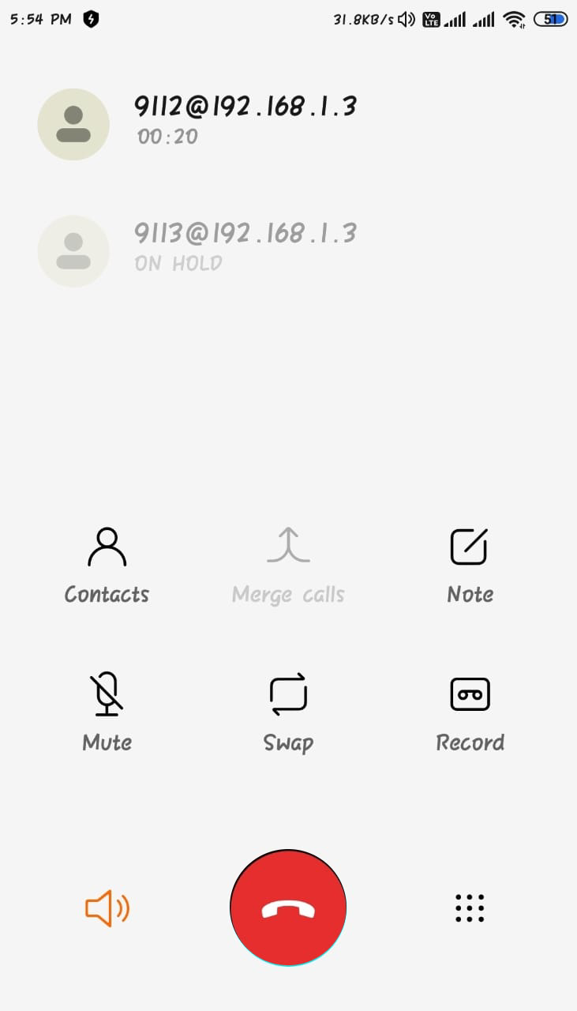
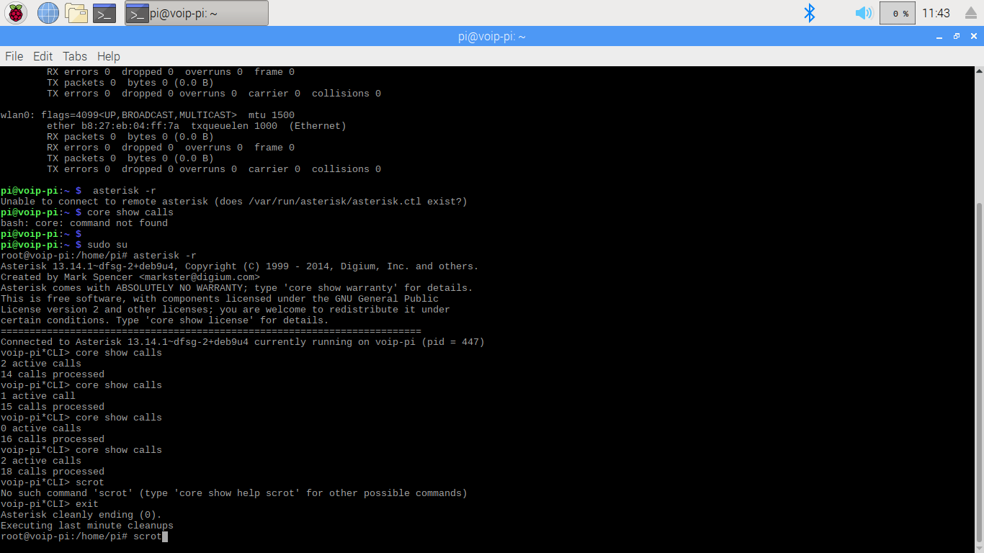

Slide 22
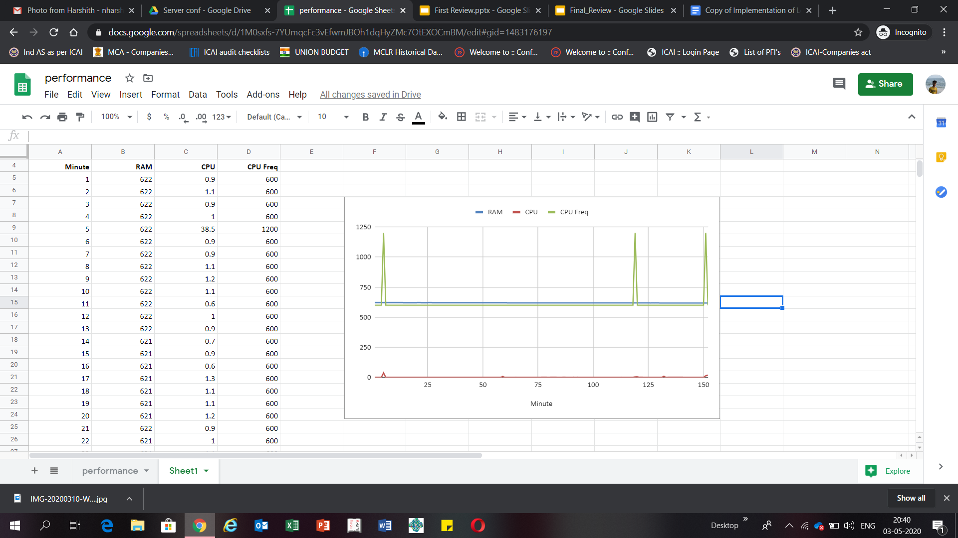

Slide 23
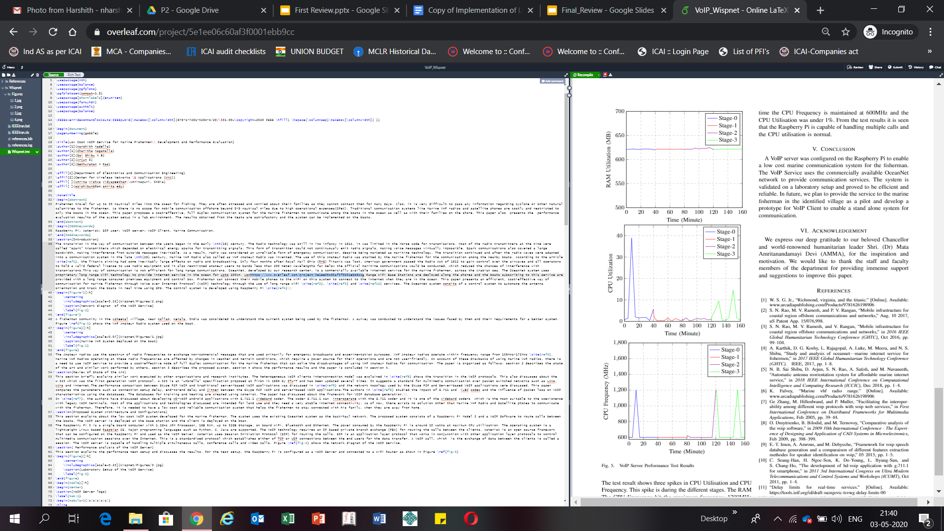
A python program was developed to monitor the performance
of the Raspberry Pi. The program captures the RAM, CPU
Utilisation and CPU Frequency of the Raspberry Pi under
different stages explained in Table 1. The data generated from
this program is stored in a MySQL Database and later retrieved
to plot the graph.

Slide 24
The test result shows three spikes in CPU Utilisation and CPU
of the Raspberry Pi and the CPU Utilisation was 38.5% for
Stage 1, 8.5% for stage 2 and 14.7% for stage 3. Rest of the
time the CPU Frequency is maintained at 600MHz and the
CPU Utilisation was under 1%. From the test results it is seen
that the Raspberry Pi is capable of handling multiple calls and
the CPU utilisation is normal.

Slide 25
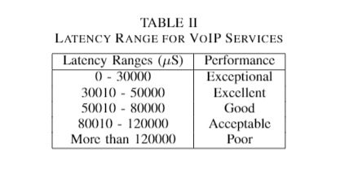
Standard Latency Ranges of Asterisk Server: Asterisk Open Source
https://support.digium.com/community/s/article/How-do-I-determine-the-latency-of-my-Asterisk-server

Slide 26
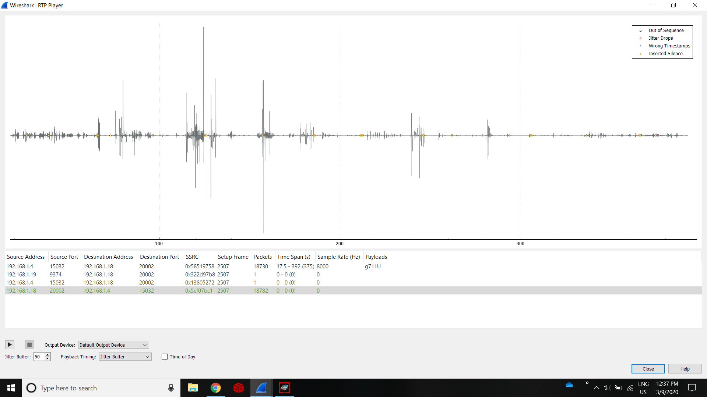

Slide 27
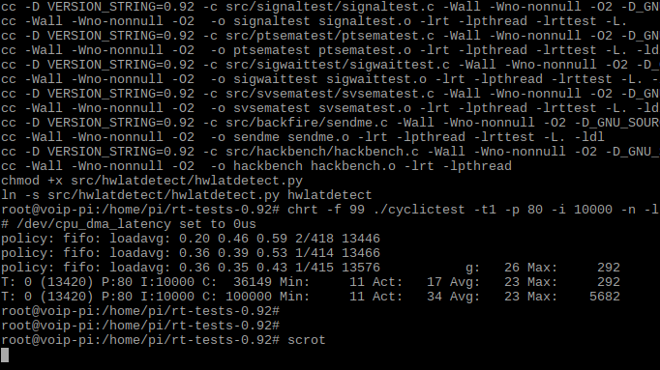
Using Cyclic Test Tool:Real-Time
Latency: 56.82ms

Slide 28



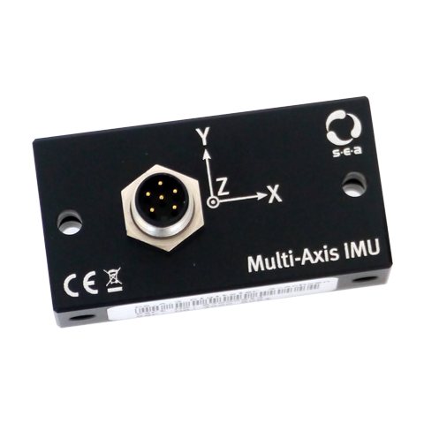

Future Works
Proposed Emergency Services
OceanNet Backhaul
GPS
Server & Data Center
Access Point
IMU Sensor
VoIP
1) Low cost Wireless Access Point
2) Voice and Video Calls from Edge Server
3) GPS Geolocation and Live tracking
4) Accident detection in boats
5) Sea State Alerts
6) Ocean weather and natural calamities warnings
7) Online Fish market link
Beneficiaries

Slide 29
References:
1) “Latency in asterisk server.” [Online]. Available:
https://support.digium.com/community/s/article/How-do-I-determine- the-latency-of-my-Asterisk-server
2) “Delay limits for real-time services.” [Online]. Available:
https://tools.ietf.org/id/draft-suznjevic-tsvwg-delay-limits-00
3) A. Karthik, D. G. Koshy, L. Rajagopal, A. Luke, M. Meera, and N. S.Shibu, “Study and analysis of oceannet—marine internet service for fishermen,” in 2017 IEEE Global Humanitarian Technology Conference(GHTC). IEEE, 2017, pp. 1–8.
4) C. Seung-Han, H. Ngoc-Son, K. Do-Young, L. Byung-Sun, and S. Chang-Ho, “The development of hd-voip application with g.711.1 for smartphone,” in 2011 3rd International Congress on Ultra Modern Telecommunications and Control Systems and Workshops (ICUMT), Oct 2011, pp. 1–4.
5) https://ieeexplore.ieee.org/document/8782343

Slide 30
Thank You!

